Slide 1
ML Models
DATAHACKS 2020 WORKSHOP
Presenter: Katyaini

Slide 2

Agenda
Steps to Deal With a ML Problem
Machine Learning Models
Linear Regression
Logistic Regression
SVM
Perceptron
Clustering
Model Interpretation

Slide 3
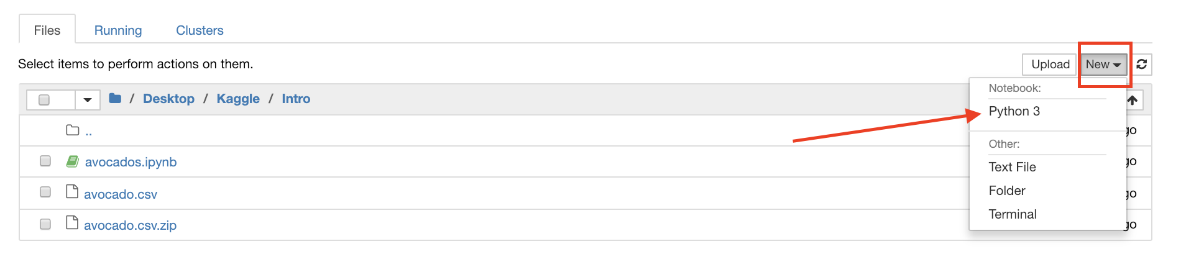
Jupyter Notebooks
Jupyter notebooks allow for live visualization of your datasets, making it a lot easier to work with, as opposed to constantly printing information out.

Slide 4
Regression vs. Classification
Regression: predicting continuous values for Y
Ex. house prices in San Diego
Ex. temperature for tomorrow
Classification: predicting discrete values for Y
Ex. email: spam vs. not spam
Ex. animal: cat or dog or rabbit

Slide 5
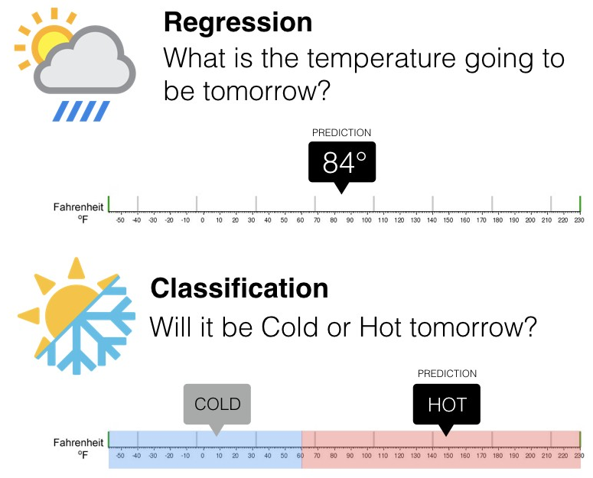
Example
Continuous
Discrete

Slide 6
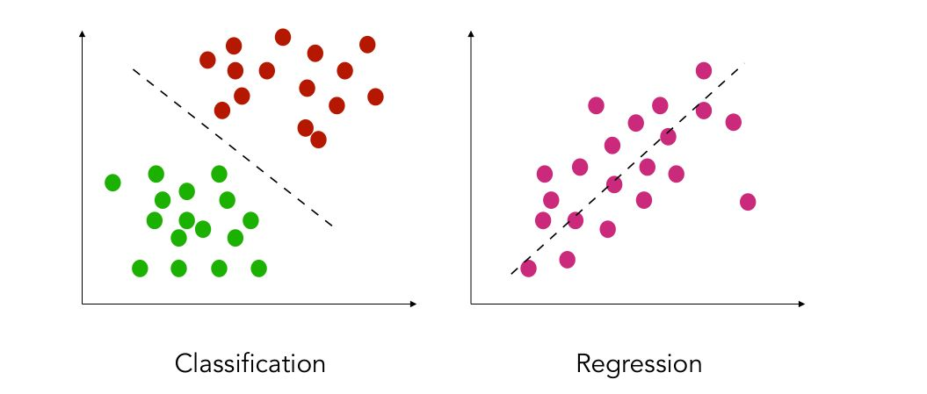
Data Representation

Slide 7
Linear Regression
Supervised Learning - basically means you have
Input as well as output in your dataset!
The core idea is to try to find the line that best fits
the dataset.
Finding relationships between continuous variables
The line is chosen in order to reduce the total
prediction error.
Super basic, use when you want to model how different
kinds of input parameters impact the output!

Slide 8
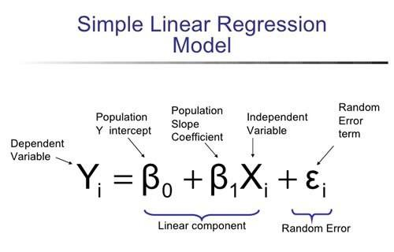
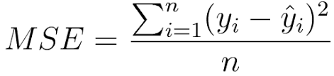
Math Behind Linear Regression
Modeling your dependent variable(the Y values) based on your independent variables (the X values)

Slide 9
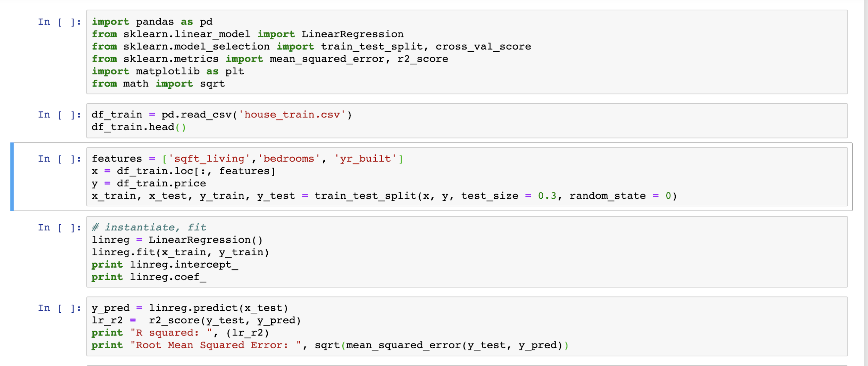
DEMO - House Price Prediction

Slide 10
Logistic Regression
Classification algorithm - works best for binary
classification!
Used to model the probability of a certain data point
existing in either group-A or group-B using something called a sigmoid function.
Trying to find a decision boundary that separates the
data to minimize the no of incorrectly classified points.
Most common example - classify email as spam or not

Slide 11
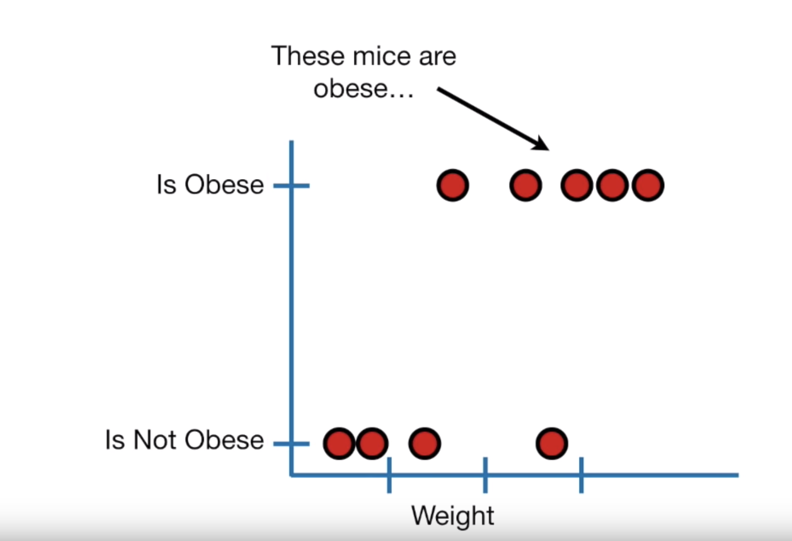
Predicting whether mice are obese based on variable weight

Slide 12
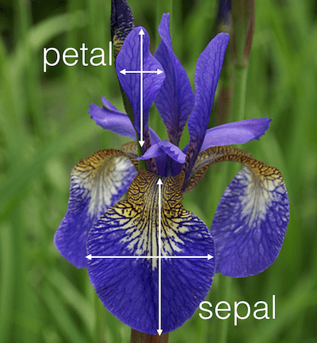
DEMO
4 Features:
Sepal Length
Sepal Width
Petal Length
Petal Width
3 Classes:
Setosa
Versicolour
Virginica

Slide 13
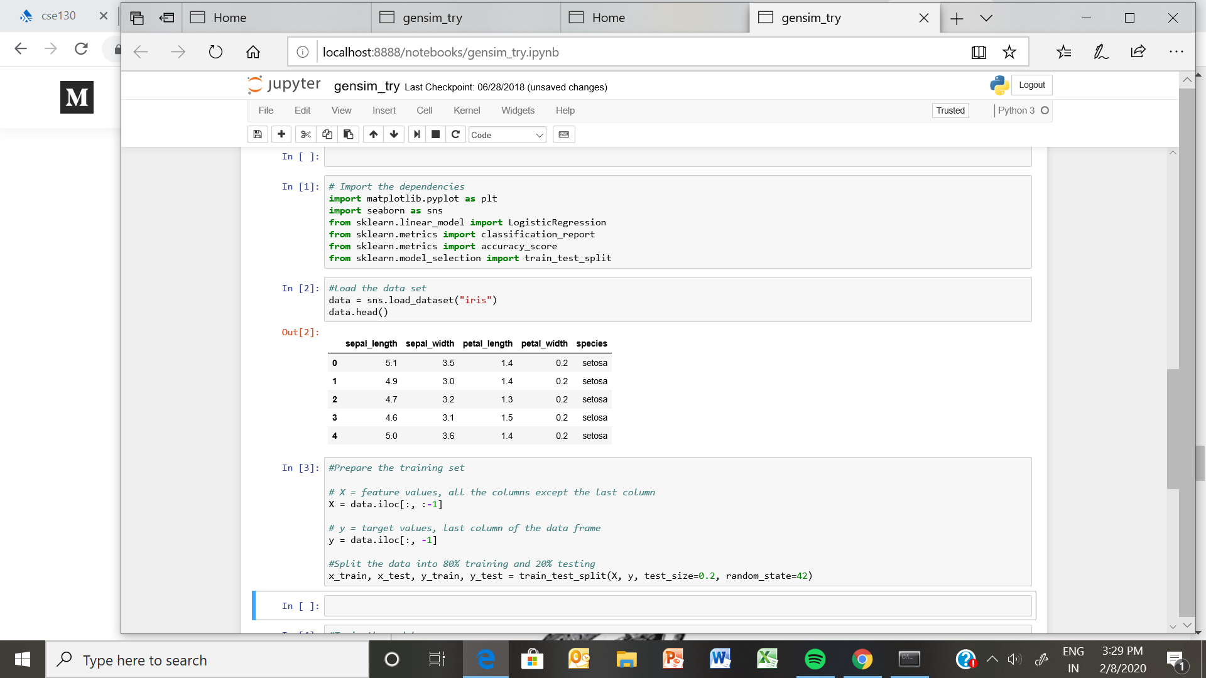
Loading the dataset + Splitting

Slide 14
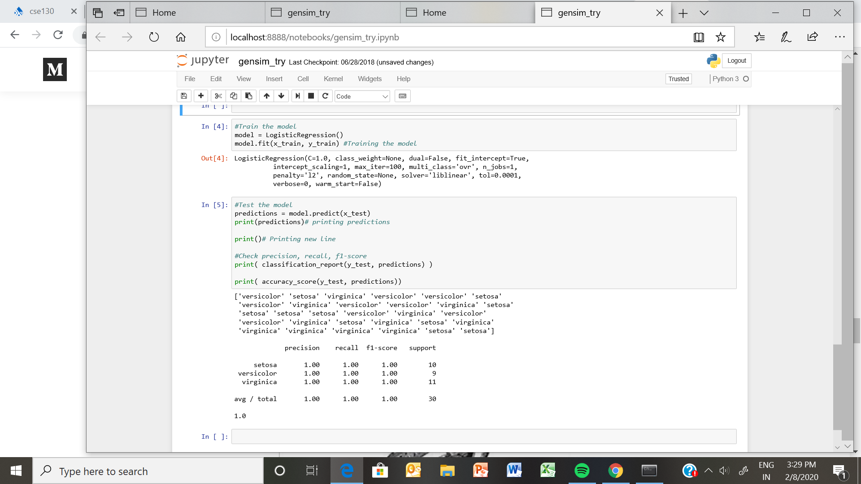
Running Logistic Regression

Slide 15
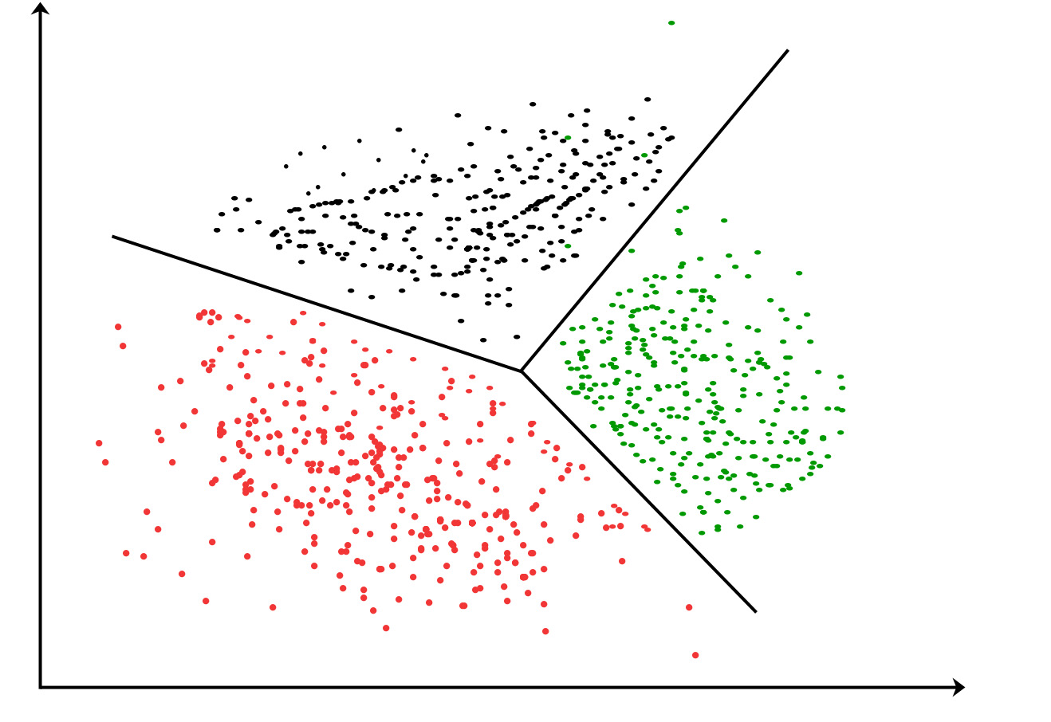
Clustering - KMeans
Unsupervised learning
Dividing the data-points into groups based on similar
traits.
K means is an iterative clustering algorithm that aims
to find local maxima in each iteration.
Randomly assign each point to a cluster
Compute cluster centroid: Use mean(each point in cluster)
Re-assign each point to closest centroid
Re-compute centroid
Other kinds like hierarchical, choose which one to use
based on what dataset looks like

Slide 16
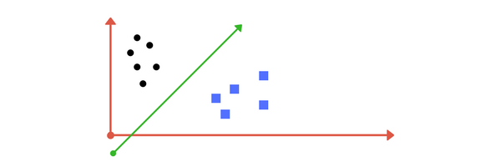
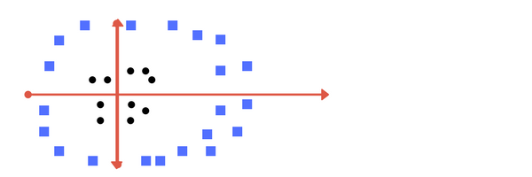
SVM
It finds out a line/ hyper-plane in multidimensional space that separates out classes!
Simple-line separation
Hyperplane separation

Slide 17
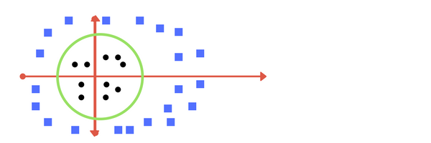
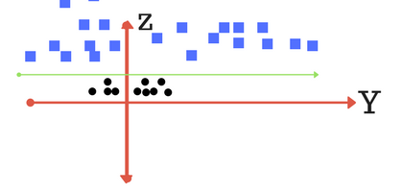
What is a hyperplane?
Adds one more dimension as we call it z-axis. Let us assume value of points on z plane, w = x² + y²
The sklearn library's SVM implementation provides the transformations inbuilt
When we transform back this line to original plane, it maps to circular boundary. These transformations are called kernels.
Notes:
For linear svm implementation : specify kernel to be linear

Slide 18
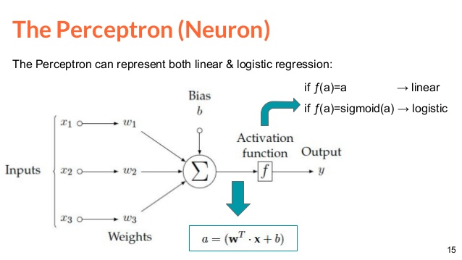
Perceptrons
A perceptron is a single layer neural network
Fun Fact: A single perceptron with a sigmoid activation is the same as a logistic model
Notes:
F could be like a step function where if w.x + b > 0 --->1 and else classify as 0.
Think of it as a binary classifier(linear)
it will never get to the state with all the input vectors classified correctly if the training set D is not linearly separable, i.e. if the positive examples cannot be separated from the negative examples by a hyperplane

Slide 19
Data Splitting - Why?
Training Data: The data used to fit the model. Model sees and learns from the data
Validation Set: Used to tune the model parameters. Sees the data but never learns from it
Test Set: Test out the accuracy of the model on a dataset it has never seen before.
K-fold Cross Validation: Resampling the test data multiple times to avoid the problem of getting different accuracies on different test sets.
Notes:
Overfitting : model does well on training data but performs horribly on test data.

